Slide 1

Dhruv Kanther
22/05/2025

Slide 2
Problem Statement
AstroSage aims to optimize the efficiency, customer satisfaction, and profitability of its call center operations. With the rising number of calls and diverse interaction types (calls, chats, consultations), management requires insights into:
Call volume fluctuations and agent workload
Customer satisfaction drivers
Operational costs and earnings breakdown
Repeat caller patterns and platform usage
Strategic investment areas: hiring, training, or technology upgrade

Slide 3
Data Overview & Structure
Data Source: Call center log data from AstroSage’s internal database.
Data Snapshot:
Total Records: 28,027 connections
Time Period: December 2023 – January 2024
Total Attributes: 35 columns
Key Fields:
user, guruName, consultationType, callStartTime, callEndTime, rating
callChannel, userCallStatus, chatStatus, astrologersEarnings, netAmount
Data Types:
Categorical: consultationType, region, userCallStatus, guruName, etc.
Numerical: call duration, rating, earnings, amount
DateTime: callStartTime, createdAt
Data Cleaning Performed:
Removed duplicates and missing values
Standardized category names
Handled outliers in call duration and earnings

Slide 4

What is AstroSage ??
AstroSage is a popular platform for exploring Vedic astrology, offering a range of services from basic horoscopes to advanced astrological consultations.

Slide 5

How does AstroSage work ?
Generates Personalized Horoscopes (Kundali):
Users can input their birth details to create a personalized birth chart.
AI-Powered Astrology:
AstroSage utilizes AI to provide astrological insights and interpretations.
Astrological Consultations:
Users can connect with expert astrologers for personalized guidance.

Slide 6


Analytical Approach and Tools
Data Cleaning: Utilized functions like TRIM, CLEAN, and Remove Duplicates to ensure data accuracy.
Data Enrichment: Enhanced the dataset with additional variables using VLOOKUP, XLOOKUP to cross-reference external data sources.
Descriptive Analysis: Employed PivotTables for summarizing key metrics and identifying sales patterns across different regions and product categories.
Customer Segmentation: Applied SORT and FILTER functions to classify customers based on Consultation type and year.
Visualization: Created dynamic charts and dashboards for data representation, enabling interactive data exploration.

Slide 7
Major Findings

Slide 8
Usage Share Across Platforms
Among the available platforms, Gurucool emerges as the most utilized, indicating that it offers a user-friendly interface and an engaging experience for users.
On the other hand, the dashboard is significantly underutilized, which may point to usability challenges or a lack of interactive features.
This contrast highlights the need to evaluate and enhance the dashboard’s design and functionality to improve user adoption and satisfaction.

Slide 9
Although the chat volume contributes to 79% of volume share but it contributes only 21% to revenue share
Call volumes is 30% only but contributes 70% to revenue share
Revenue vs Volume Comparison

Slide 10
Total Sales Generated from each category
The chart compares the revenue and payouts to astrologers across different types of consultation formats, showing that Call consultations are the most profitable for the platform.

Slide 11
Daily Call Volumes
The high and variable chat volume may reflect strong demand, but it could also indicate service instability or varying availability of agents.
The stable call volume suggests consistent user interest and possibly better-managed capacity.
Complementary usage patterns imply event-driven engagement.
The minimal uptake of public_live_Calls suggests the need for evaluation of relevance, promotion, or feature usability.

Slide 12
Change in daily call volume day by day
Average Daily Call Volume : 250
The chart and the pivot data displays the change in daily call volume.

Slide 13
Hourly Distribution of Calls
The chart depicts the hourly distribution of the calls between 01-December and 03-January.
008:00 to 14:00 are the busiest hours, especially 08:00 (660 calls) and 10:00 (605 calls).

Slide 14
Average of Call/Chat Duration
Average User on Call (in mins)
~118 mins
Average user on Chat (in secs)
~350 secs
The chart displays the high difference in Average call and chat duration.

Slide 15
Call / Chat Status
Chat interactions face higher failure and incompletion rates compared to calls, highlighting potential issues with user engagement or technical limitations in the chat system.
Call sessions show a relatively better success rate, but the high rate of no-answers and busy signals an opportunity to optimize scheduling or user notifications.

Slide 16
Average Rating by Consultation Type
Call consultations also performed well, with an average rating just below Complementary, indicating reliable and effective user experiences.
Chat sessions had the lowest average rating, highlighting a potential area for service improvement—possibly due to response delays, lack of clarity, or agent availability.

Slide 17
User Satisfaction Trends by Consultation Mode
Call consultations are the most consistent in user satisfaction.
Chat consultations have fluctuating ratings, which might need quality control

Slide 18
Rating wise gurus and user distribution
Majority of users rated between 3–5 and Guru rating distribution also peaks around 3–5, meaning training could elevate it. And very few high ratings (6–8), indicating room for service quality improvement

Slide 19
Top-10 Gurus based on Ratings
The ratings shown in chart and ranking for top-10 gurus changes according to the slicers added in the dashboard
There are 3 slicers in our dashboard:
- Consultation type based
- Website based
- Month based

Slide 20
RECOMMENDATIONS
1. Improve Training Programs – Highest Impact
Chat consultations make up the majority of sessions but suffer from lower customer ratings (seen in the ratings line chart).
This directly affects customer satisfaction and profitability, since chats consume more agent time.

Slide 21
2. Upgrade Call Center Technology – Medium- Term ROI
Since chat is high-volume and long-duration, tech upgrades like:
AI chatbots
Automated response templates
Intelligent routing can drastically reduce manual workload and improve consistency.

Slide 22
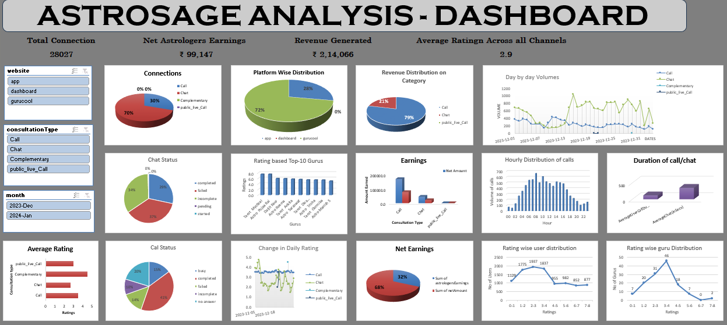
ASTROSAGE DASHBOARD

Slide 23
CONCLUSION
Over 28,000 total connections, including 8,508 calls and 19,514 chats, indicating chat is the most preferred communication mode.
Average call duration is ~119 minutes, with chat sessions averaging ~349 seconds, pointing to more detailed discussions via calls and quicker resolution via chat.
Earnings are higher for calls as compared to chats, vice versa to volume distribution
Majority of users rated between 3–5 and Guru rating distribution also peaks around 3–5-
AI chatbots
Automated response templates
Intelligent routing can drastically reduce manual workload and improve consistency.
Investment must be distributed considering the factors like training programs, revenue contribution, automations, performance based incentives, etc.
72% of usage is via dashboard, 28% via app, and 0% via gurucool.
majority of users rated between 3–5 and Guru rating distribution also peaks around 3–5

Slide 24
Acknowledgements and References
This project and the accompanying analysis were conducted independently as part of my academic coursework.
I would like to express my sincere gratitude to Rishabh Verma for their invaluable guidance in Excel and Newton School for all the support and insights provided through the course materials, which played a crucial role in shaping this work.
Thank You

